Slide 1
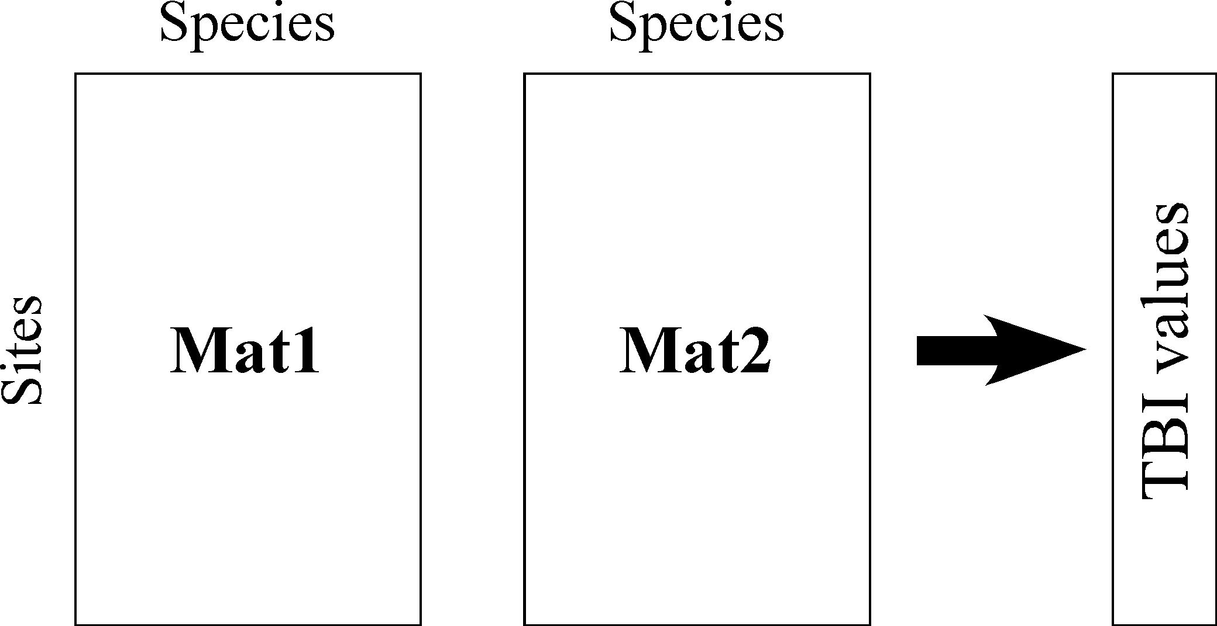
T1_{i}
T2_{i}
D_{i}

Slide 2
p species
p species
n sites
Time 1: Mat.1
Time 2: Mat.2
TBI values

Slide 3
p species
p species
T1₁
T2₁
D₁
T1₂
T2₂
D₂
…
…
…
n sites
Mat.1
Mat.2
TBI values
Time 1
Time 2

Slide 4
Time 1: Mat.1
Time 2: Mat.2
p species
p species
n sites
mat.1
n sites
mat.2

Slide 5
p species
p species
T1₁
T2₁
D₁
T1₂
T2₂
D₂
…
…
…
Sites i
Mat1
Mat2
TBI values

Slide 6
L loci
T1₁
y_{1j}
T2₁
y_{1j}
D_{1.perm}
T1₂
T2₂
D_{2.perm}
…
…
…
n populations
T1₅
y_{5j}
T2₅
y_{5j}
…
…
TGI_{perm} values
T1_{n}
y_{nj}
T2_{n}
y_{nj}
Notes:
Figure S1. When using TGI, genetic data is randomly permutated separately for each locus (column). For example, the permutation of locus j in population-level genotypic matrices T1 (left) and T2 (right). This figure presents an example where a permutation of species j brings value y.1j to position y.9j and value y.5j to position y1.j. The exact same permutation, involving all values in column j, is done in matrices T1 (left) and T2 (right). Following similar permutations of all p species, the dissimilarities are computed between the two vectors representing each site i, producing the values D.i under permutation.
We are not interested in a systematic difference that would affect all sites concerning the loss or gain of a subset of the species, or of all species. Differences of this type are preserved, through the permutations, by not permuting data between Mat.1 and Mat.2. This preserves, in the permutations, the differences between Mat.1 and Mat.2 that are found at all sites.

Slide 8
2 loci
a/a
c/a
a/c
d/c
b/a
c/b
Genotype permutation per locus
Randomized indices:
L₁ (3, 1, 4, 2)
L₂ (4, 2, 1, 3)
a/a
c/b
2 populations
(4 individuals)
a/c
d/a
b/c
c/a
b/c
d/c
b/a
d/a
1st sampling

Slide 9
2 loci
a/a
c/a
a/c
d/c
b/a
c/b
Genotype permutation per locus
a/a
c/b
a/c
d/a
b/c
c/a
b/c
d/c
b/a
d/a
Same randomized indices:
L₁ (3, 1, 4, 2)
L₂ (4, 2, 1, 3)
1st sampling (T1)
2 populations : pop1 & pop2
(4 individuals)
999
c/c
b/c
d/d
c/b
a/b
a/d
Genotype permutation per locus
a/b
a/d
d/d
b/a
a/a
b/c
a/a
c/b
a/b
b/a
2nd sampling (T2)

Slide 10
2 loci
a/a
c/a
b/a
c/b
a/c
d/a
b/c
d/c
D_{pop1}(T1,T2)
1st sampling (T1)
2 populations : pop1 & pop2
(4 individuals)
D_{pop2}(T1,T2)
c/c
b/c
TGI values
a/b
a/d
d/d
b/a
a/a
c/b
2nd sampling (T2)

